Slide 1
Marcus Garnham
Henrique Treve
Ruchi Sharma
Kouame Kouassi
Shola
Movie Analysis Group members

Slide 2
Outline
We will be analysing what makes films successful in the New Millennium Era/Period of films. Which are films produced in after the 1990’s. We will be analysing what makes films successful either ratings wise or profitability wise. This will make the data very useful for those just starting or want to be apart of the movie industry or even those who are in the movie industry. We will specifically be looking at USA movies with a world wide revenue approach

Slide 3
Links:
IMDB Movies Dataset |
KaggleNetflix Movies and TV Shows |
KaggleThe Movies Dataset |
KaggleTMDB 5000 Movie Dataset | Kaggle

Slide 4
Questions:
Do movies become profitable with longer runtime?
Are different genres more profitable than other genres?
Does the runtime of the film affect the average vote?
Does the genre of a film determine or affect its average vote and runtime?
Do fan reviews by genre affect global gross revenue?
Are there directors who are more favorites, how good are the films they have directed so far and their career in general?
Does the movie release time affect the profitability the movie?

Slide 5
Q1) Do movies become profitable with longer runtime?

Slide 6
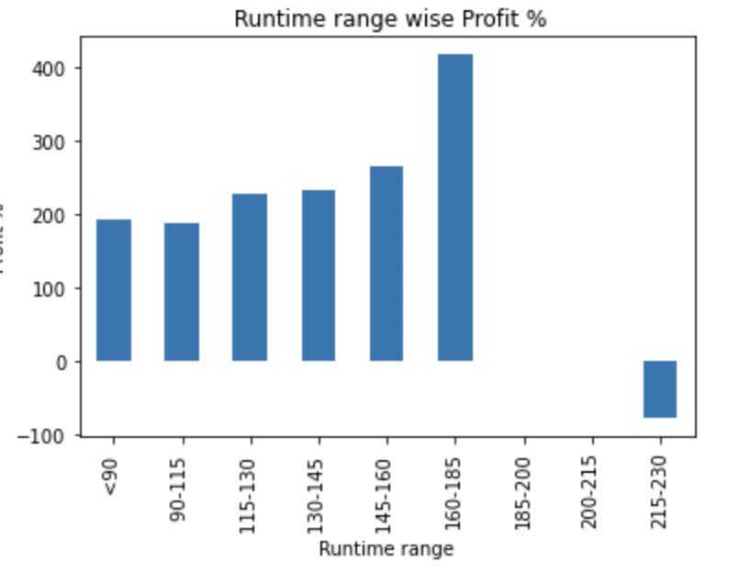
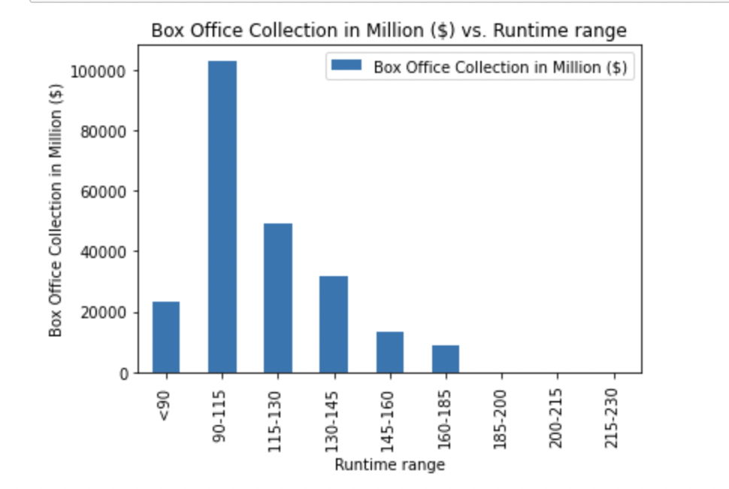
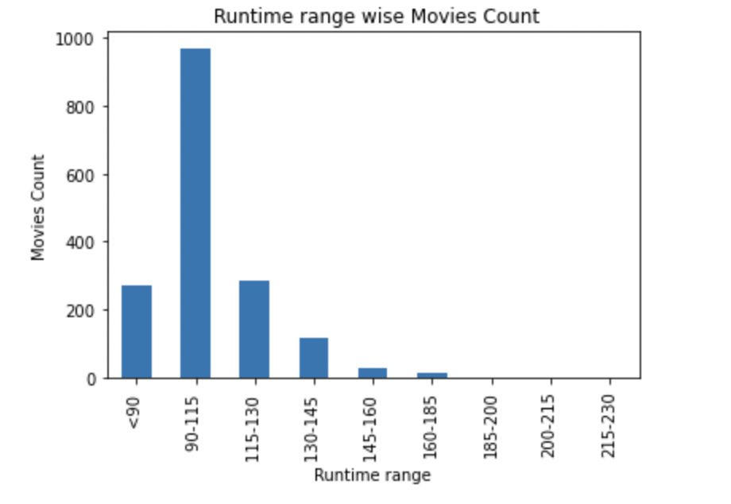
Analyzing movie runtime effect on profit%, Box office collections and number of releases. Here we can see that 90-115 range has the highest box office collection and maximum no. of releases while 160-185 runtime range made the highest profit% so we don’t find any direct relation here.

Slide 7
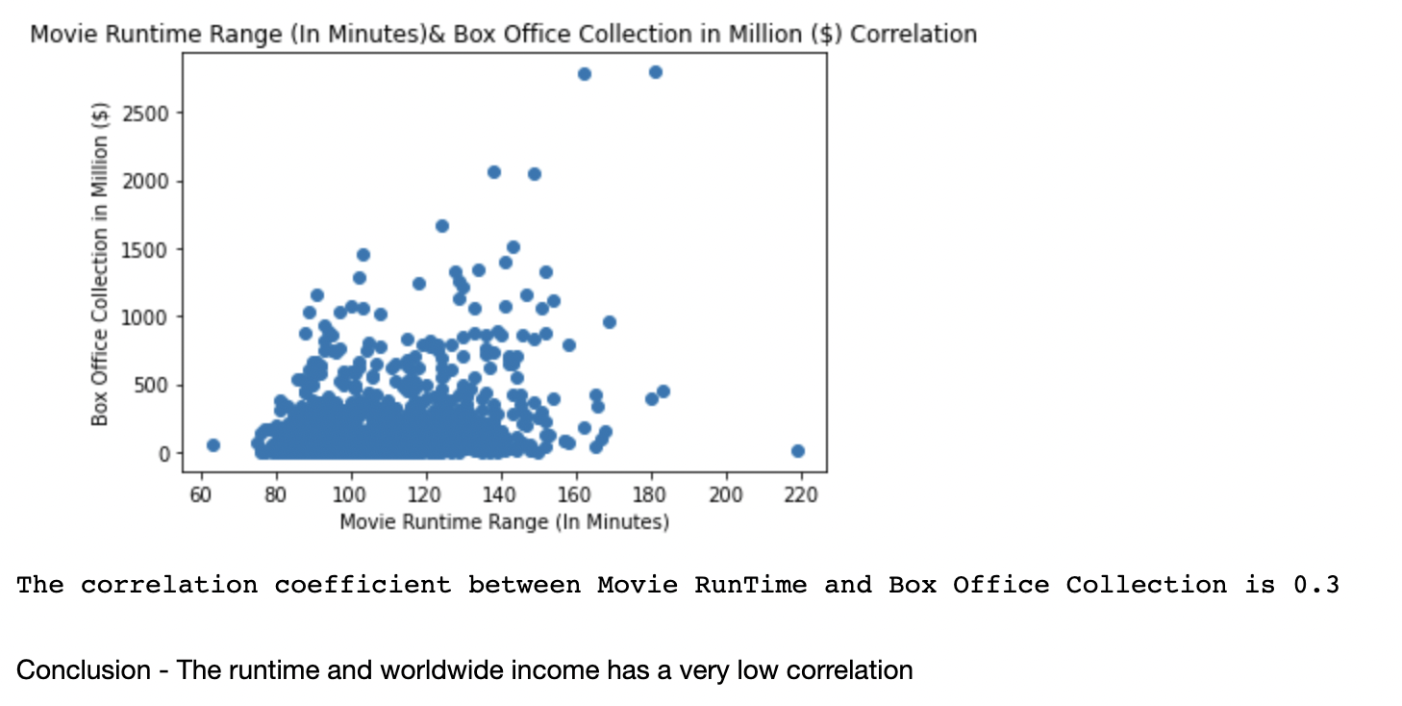
Correlation Analysis between Movie runtime range and Box Office collections

Slide 8
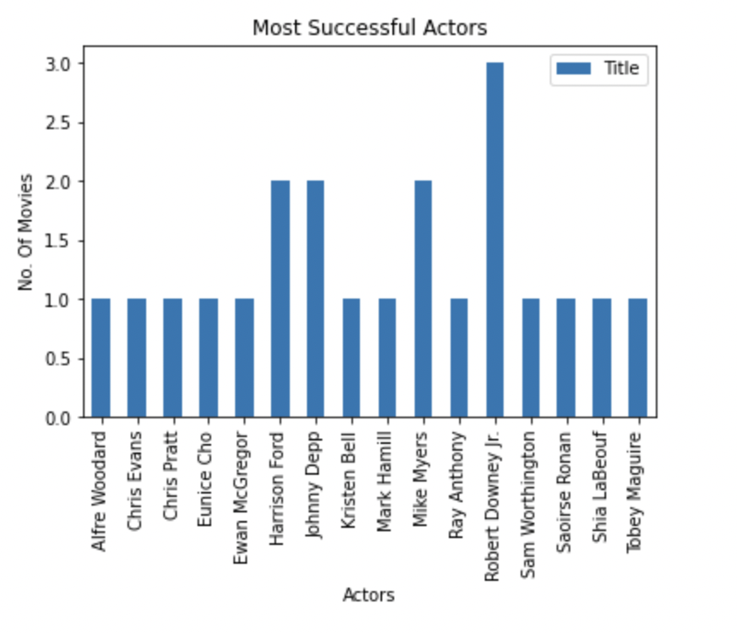
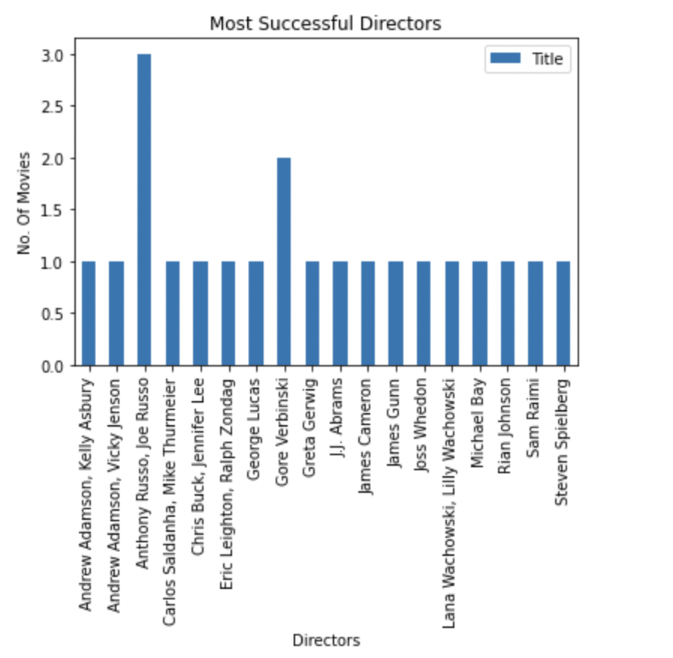
It clearly shows in actors, Robert Downey jr is the most successful actor, who has done 3 movies while Ewan Mcgregor, Johny Depp and Mark Hamill has 2 biggest blockbuster movies. Anthony Russo, Joe Russo are the top directors with 3 movies and Gore Verbinski comes second here with 2 biggest blockbuster. Note- Biggest blockbuster is the movie which has the highest box office collection and profit.

Slide 9
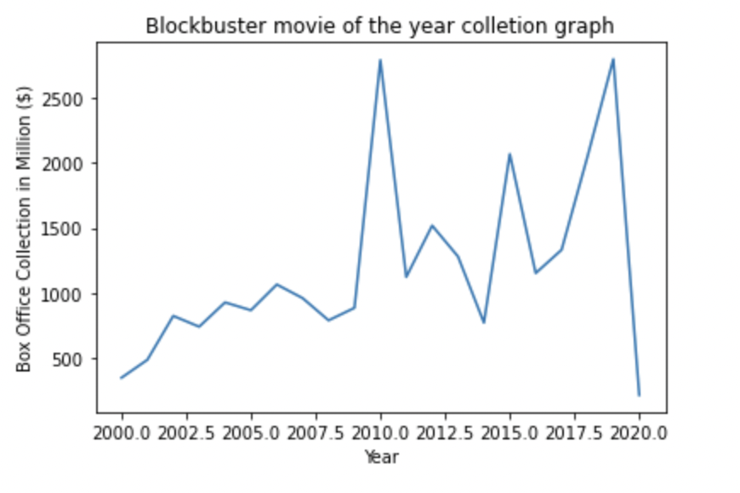
The income of the biggest blockbuster of the year is increasing increasing every year with an exceptional drop in 2020 due to global pandemic.

Slide 10
Q2)Marcus Movie Analysis
-Analysing Genre and Gross Income
-Budget and Gross Income

Slide 11
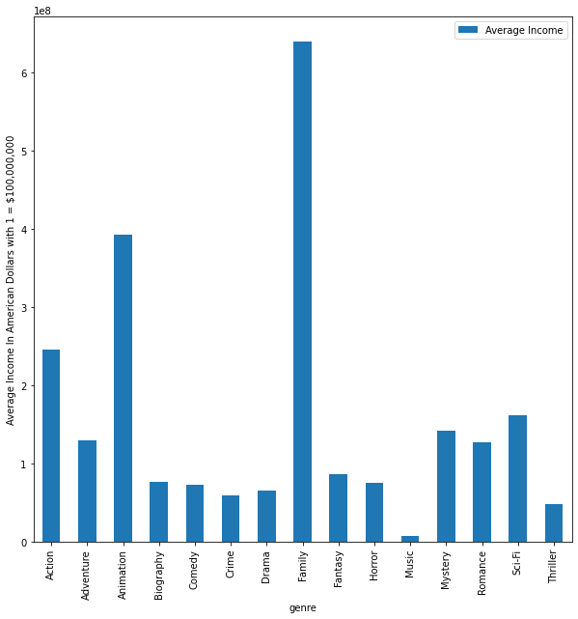
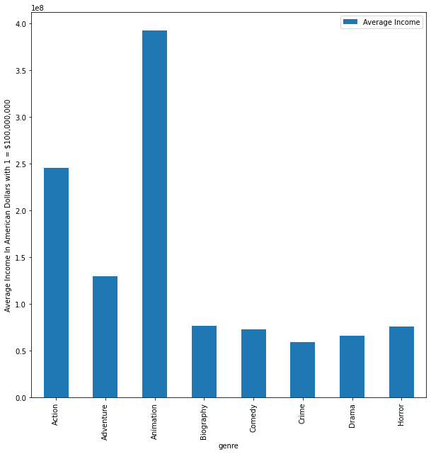
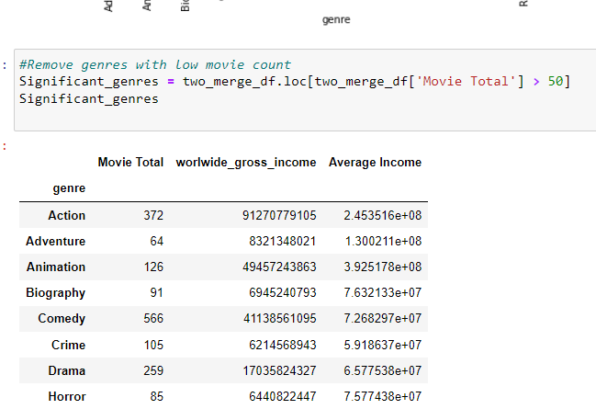
Analysis Genre all Years
Above we see the graph when we remove movies genres that have to few data points
Above we see the genres and what they make on average for all the years.

Slide 12
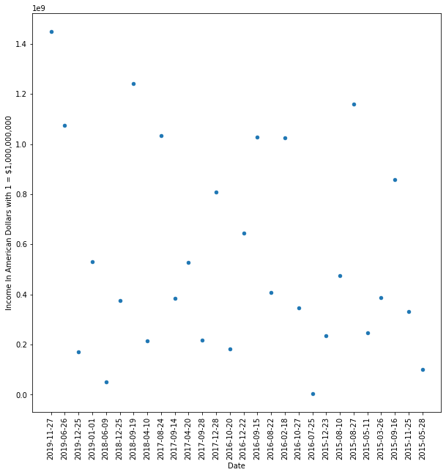
Analysis of the two Highest earning genre with significant Data.
Here we have the plot of the Income of the animation movies plotted against dates for the latest five years we have 2015-2020.
As we can see that animation movies income doesn’t trend up or down over the years so the genre is stable choice.
On the next page you can see the same is true for the action genre.

Slide 13
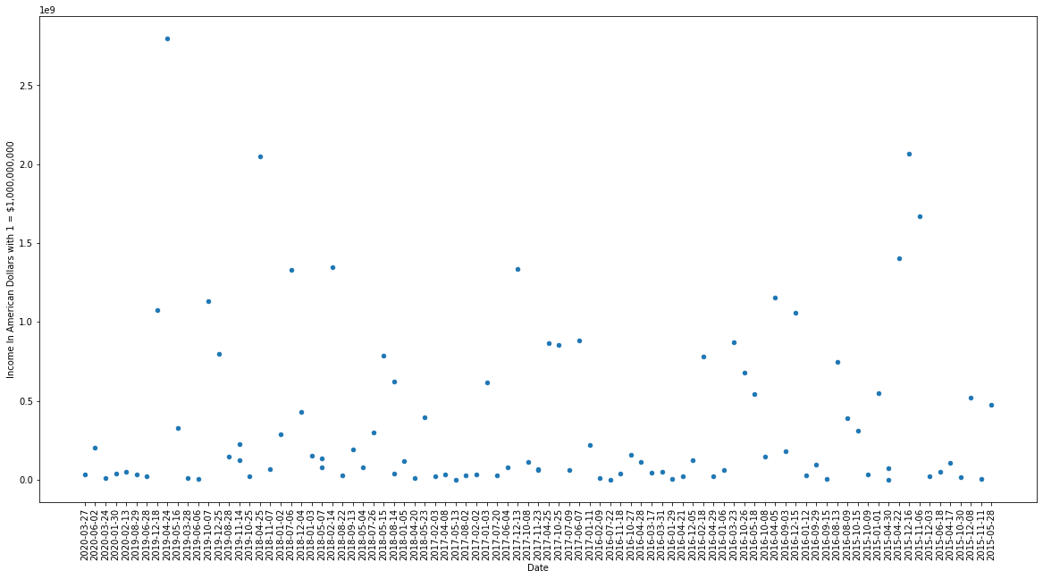

Slide 14
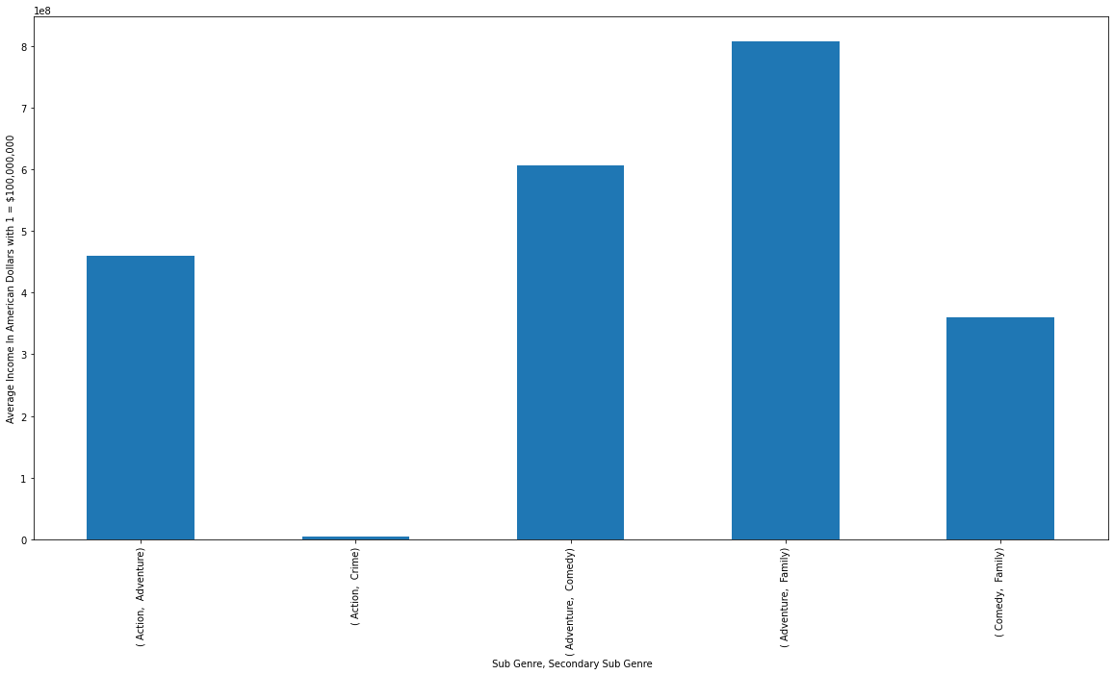
Animation Average Income of Sub genres during 2015-2020
In this we see which animation movies have the highest average income based on there sub genres.
We can see that Animation movies with the family and adventure sub categories do very.
While action crime animation movies do very poorly based the data we have.

Slide 15
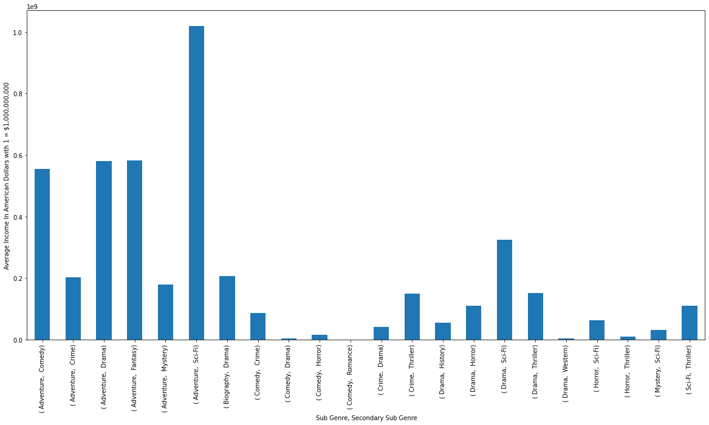
Action Movies and there sub genres Average income 2015-2020.
Here we see action movies with the sub genres and we see that action movies only really produce high incomes with certain sub genres for the last five years.
So the average income for Action genre is being held up by only several sub genre combinations and there are many you should steer away from.
The stand out combination to go for is action, adventure, sci-fi

Slide 16
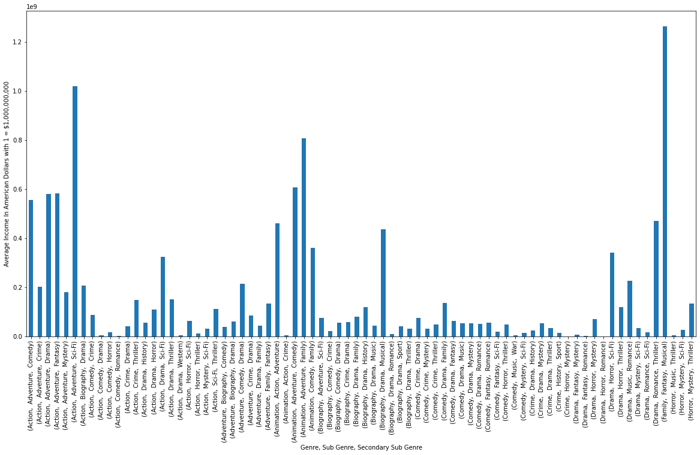
Analysis genre and sub-genre 2015-2020
I decided to analysis the last five years and see if any other genres had high average sub genre earners and where being held back by other underperforming sub genres.
You can see some drama and biography movies and similar averages to some of the top genres lower earning sub genres.

Slide 17
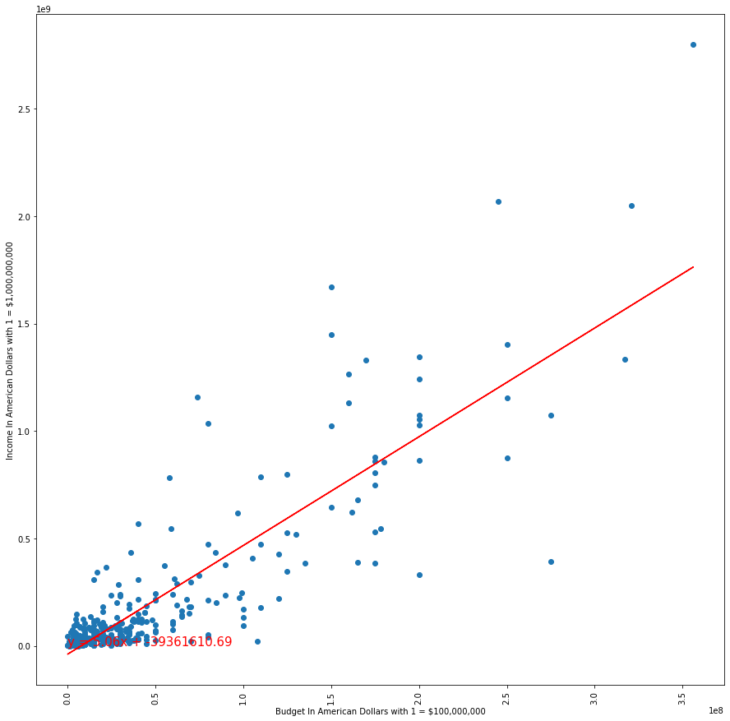
Budget vs Gross Income
Here I plotted Budget against the Gross Income to see the correlation.
As we can see there is definitely a correlation between higher budgets and higher gross income.
However once you get to the higher budgets this relation of income to budget becomes much less certain.
This means lower budget movies are more likely to make what you think they will but won’t make much above that unlike higher budget movies which are more risky but offer a greater reward.

Slide 18
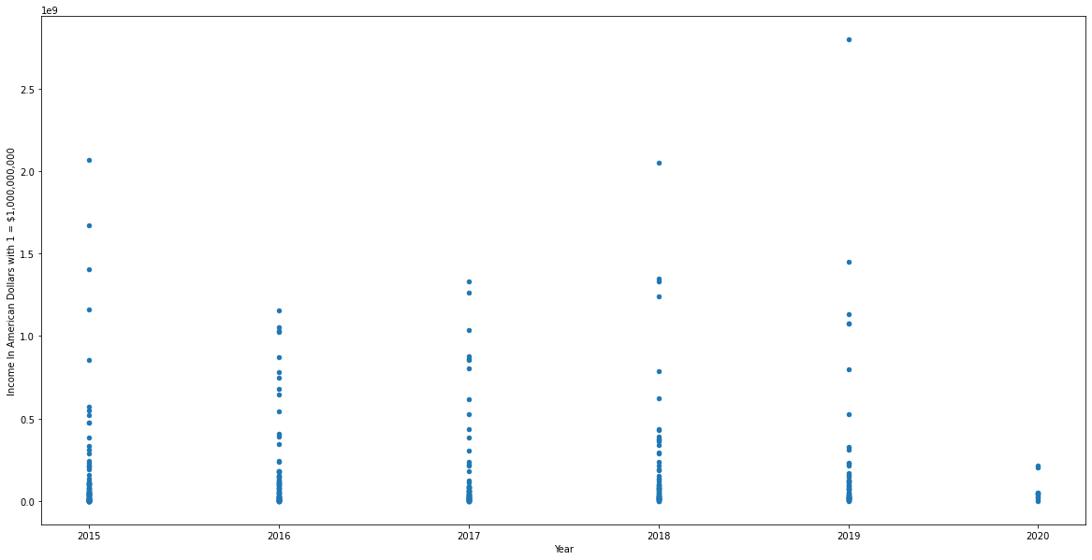
Gross income last five years
As we can see movie Gross incomes have remained stable during the latest years of 2015-2019
Though less movies to go by in the 2020 which is probably due to covid. So we can’t be entirely certian

Slide 19

Question 3: Does the runtime of the movie affect the public rating?
Fig1.
The figure shows for years before 2005, the runtime for movies was between 80 and 110 minutes, with the average vote between 4.8 and 7.6. Very few movies had a runtime outside that range, and their average vote is slightly over 6.
The data concentration change can be observed in the other three figures for both runtime and average vote. From 2005 to 2009, the data are more concentrated between 80 and 140 minutes for the runtime, with the average vote between 5 and 7.4. It is also possible to observe that more movies had a long runtime during those years with a relatively high average vote.
The Dynamic is the same for 2010-2014 and 2015-2020. In which the visualizations show a different concentration of data.

Slide 20
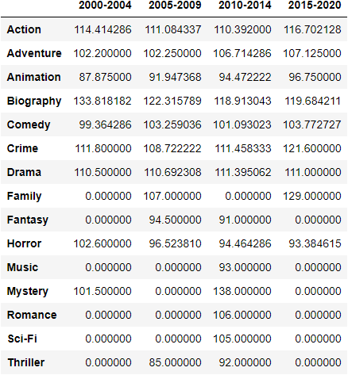
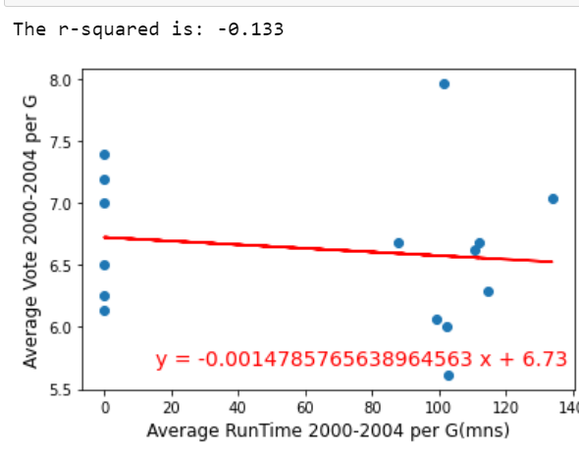
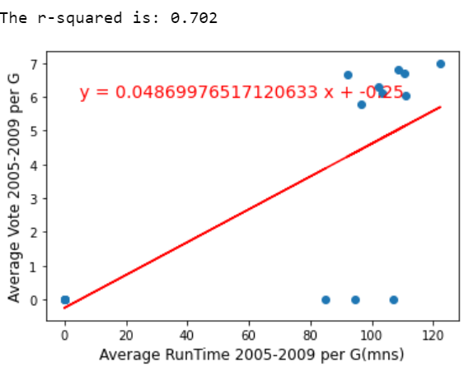
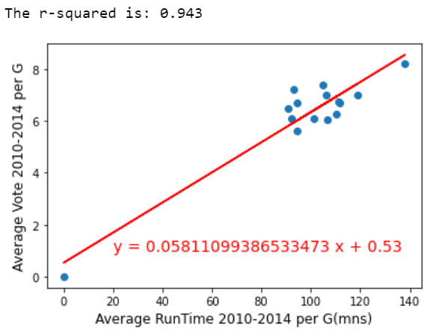
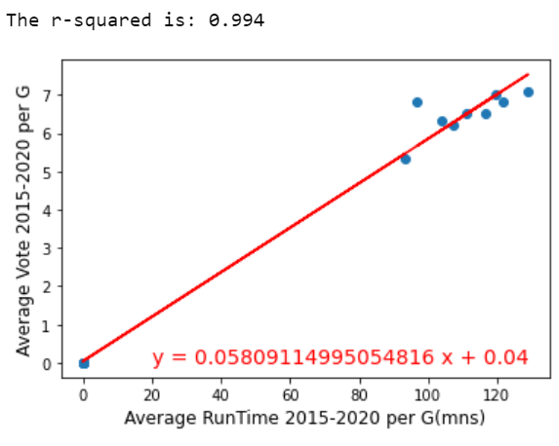
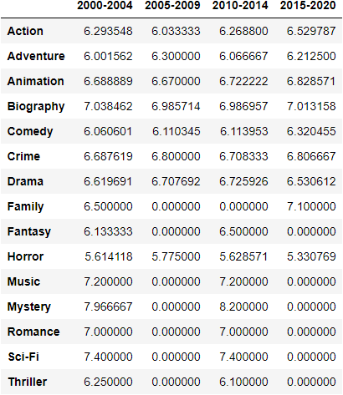
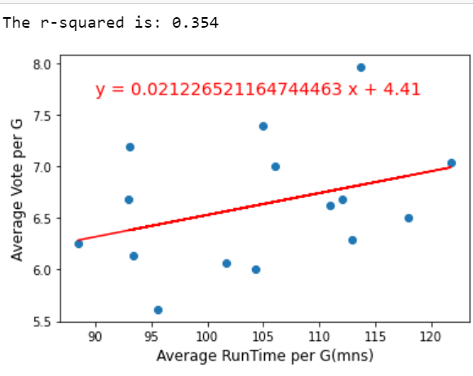
fig1. yearly range Average Runtime per movie genre
determining the relationship between the average vote and the average runtime for genres in four ranges of year.
In the range 2000-2004, the regression line is decreasing, and the R-value is -0,133, which highlights the negative correlation between the average vote and the runtime. It can be observed that the data are far from the regression line.
On the contrary, the three other ranges of year have a positive regression lines showing a positive dependence between the two values of the analysis as shown by the respective R-values. it is also shown that the intervals 2010-2014 and 2015-2020 have a R-value almost equal to 1 which shows an almost perfect linear correlation between the average vote and the average runtime.
The range 2015-2020 has a R-value equal to 0.994 which shows the highest dependence of the average vote on the average runtime.
The observations show that the data tend to cluster in a certain area around the regression line except for the figure with years between 2000 and 2004. in many cases an increase in the average length of the movie by genres has a direct proportionality with the average vote.
fig2. yearly range Average vote per movie genre
Avg vote vs Avg Run Time 2000 - 2020

Slide 21
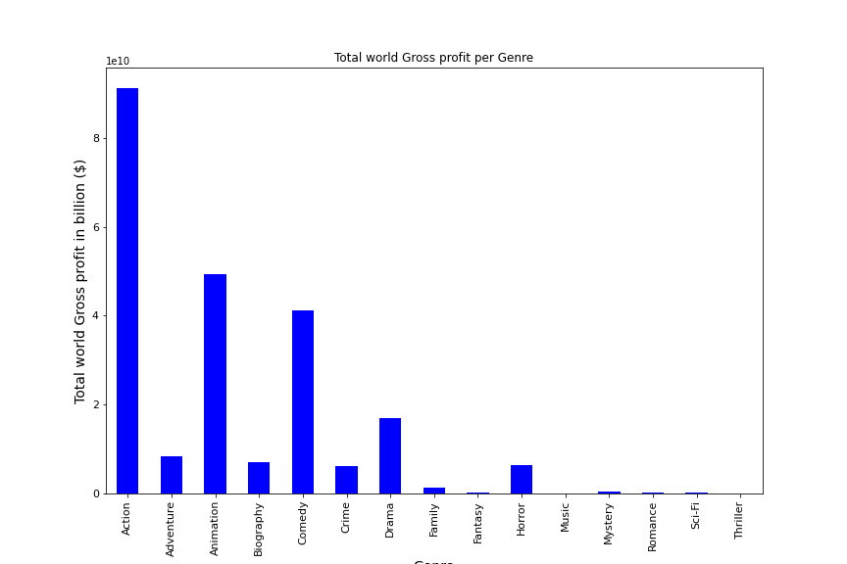
Q4) Does the genre of a movie determine or affects its public rating and runtime?
Determine the worldwide gross incomes per genre in the twenty years time frame and
Fig3. The worldwide gross incomes in billion per genre in the twenty years time frame
From the bar chart, Action movie has the highest worldwide gross income with more than 91 billion dollars, followed by animation with 49 billion dollars and comedy with 41 billion dollars. In comparison, music has the lowest worldwide gross income, with only a gross income of almost 8 million.

Slide 22
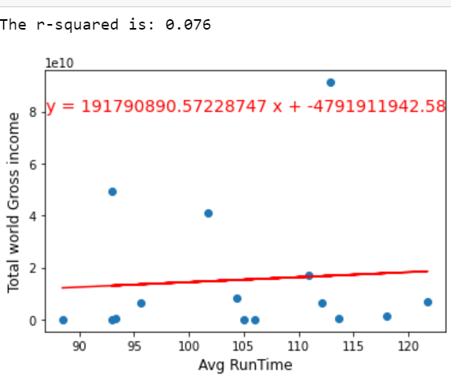
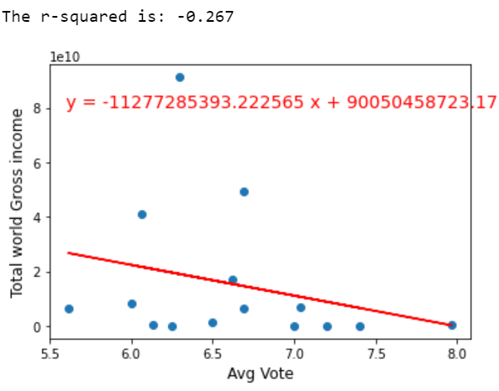
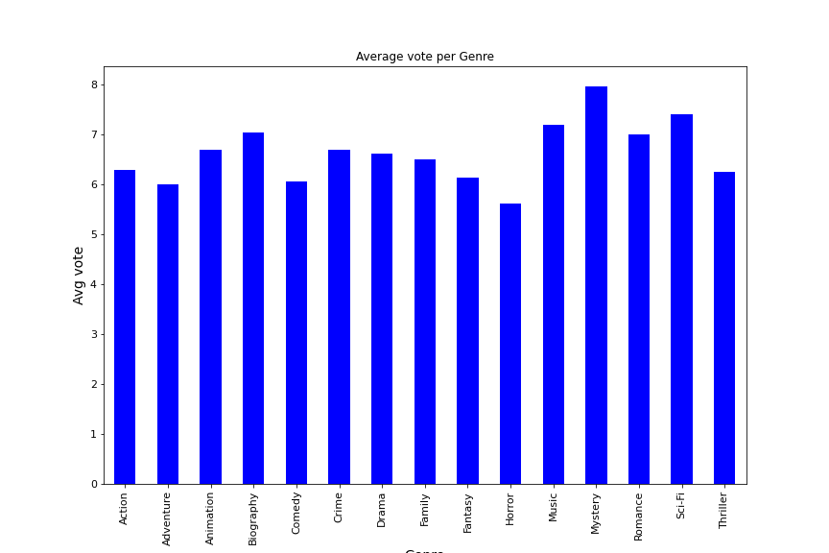
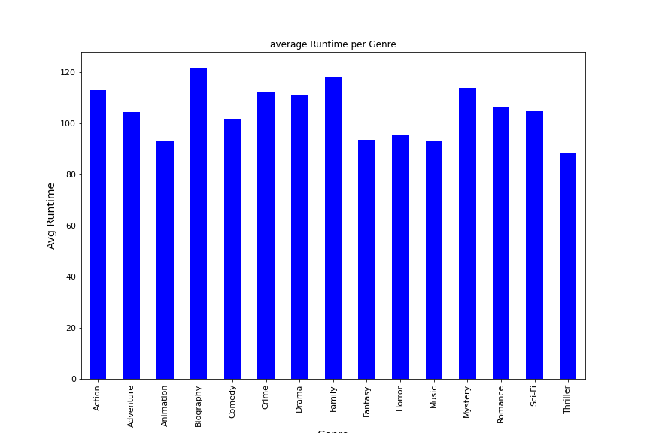
Analysis of the worldwide gross incomes per genre in relation with the average vote, average runtime
Regarding the average runtime per genre in the considered time frame, Biography has the highest average runtime of 122 and thriller with a runtime of 88. However, the average runtime for the other genres appears more or less relatively uniform, with no significant difference. The regression line of the worldwide gross income is almost flat, showing an insignificant relationship between the two factors.
Concerning the average vote, the only difference with the previous analysis is that the regression line is negatively inclined, which highlights an inversely proportional relationship between the worldwide gross income and the average vote. Furthermore, the R-value is negative, confirming the finding.
The linear regression line between the Average Run Time and average vote of each genre from 2000 t0 2020 has a positive bias. However, with an R-value equal to 0.354, the interdependence between the two factors is partially linear.

Slide 23
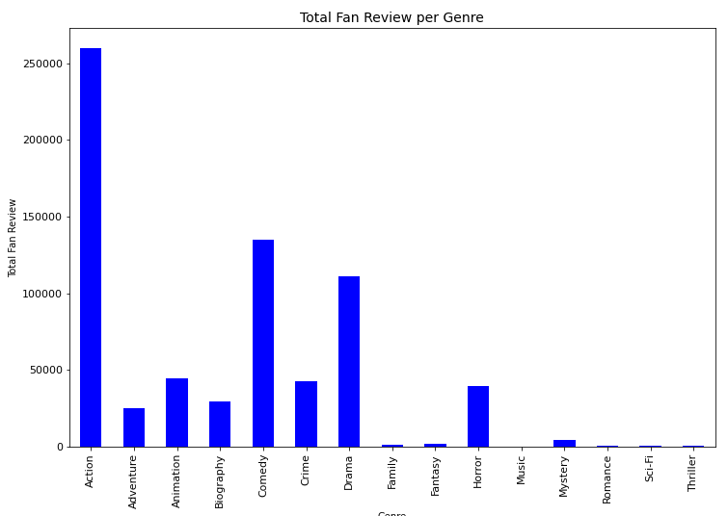
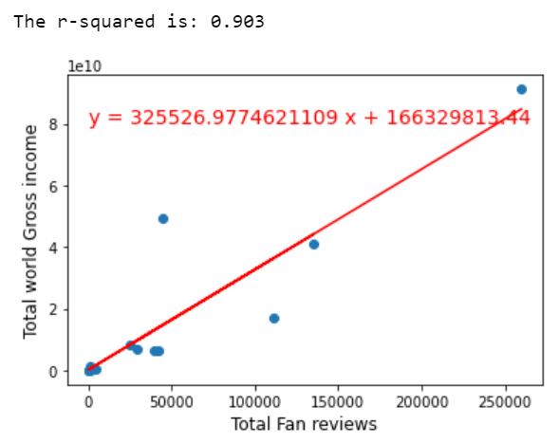
Q5) Analysis of the worldwide gross incomes per genre in relation with the Total Fan reviews
The bar graph shows that in addition to the action genre, which has the highest number of reviews in the 200-2020 range, the comedy genre ranks second, followed by the drama genre in the third position. This positioning differs from that obtained with the worldwide gross income by genres. In fact, in this ranking, the animation genre has a lower total number of fan reviews than comedy and drama. The data also show an almost perfect but non-linear relationship between the worldwide gross income by genre and the sum of fan reviews by movie genre. The linear correlation coefficient is equal to 0.9, a sign of a high linear interdependence.

Slide 24
Q6) Are there directors who are more favorites, how good are the films they have directed so far and their career in general

Slide 25
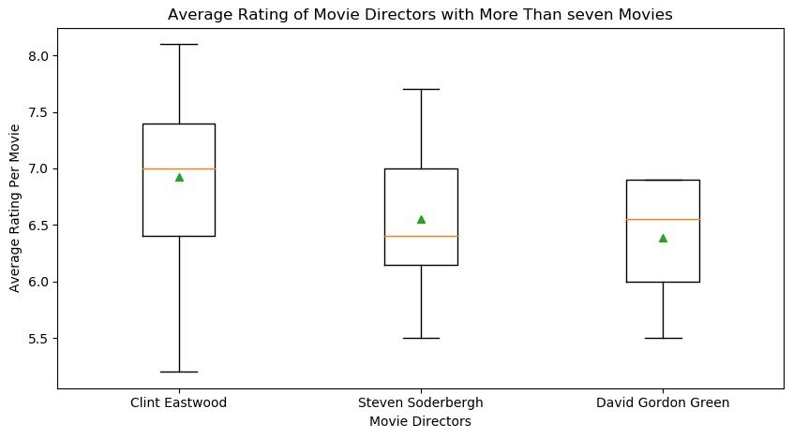
are there movie directors that are more favoured, how good are the movies they have directed so far and their career overall?

Slide 26
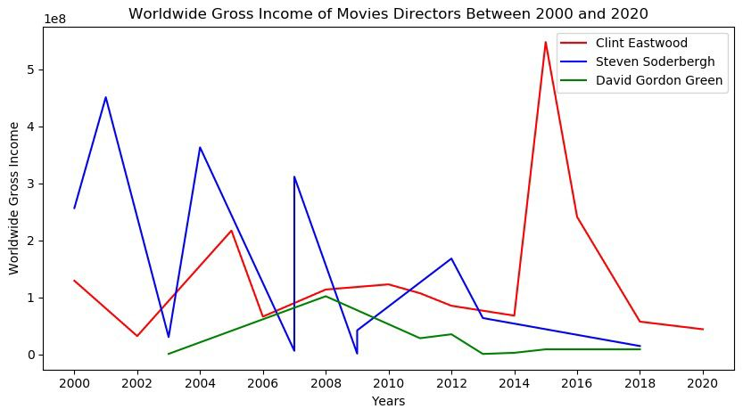

Slide 27
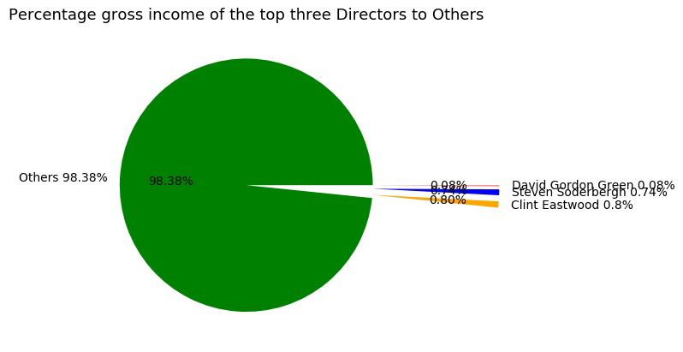

Slide 28
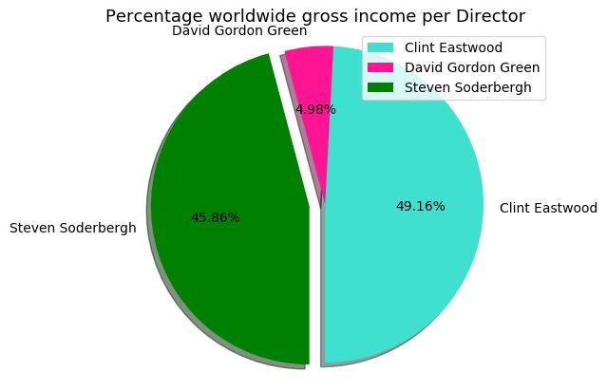

Slide 29
Q7)Does the movie release time affect the profitability the movie?

Slide 30
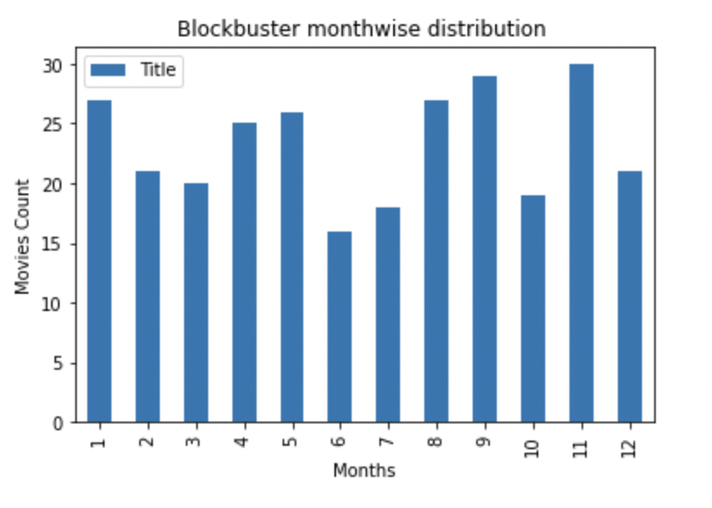
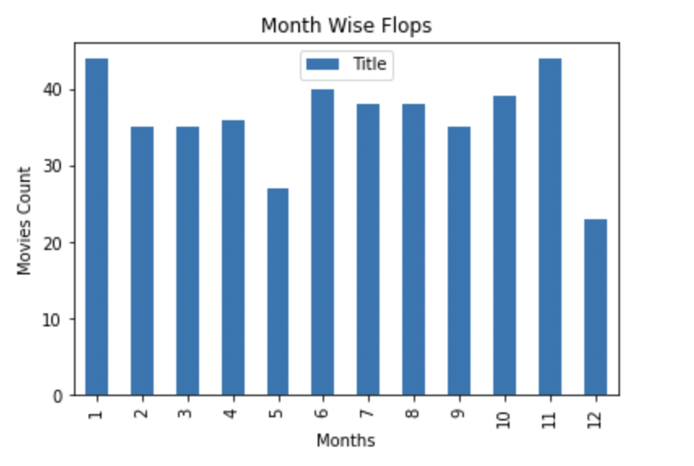
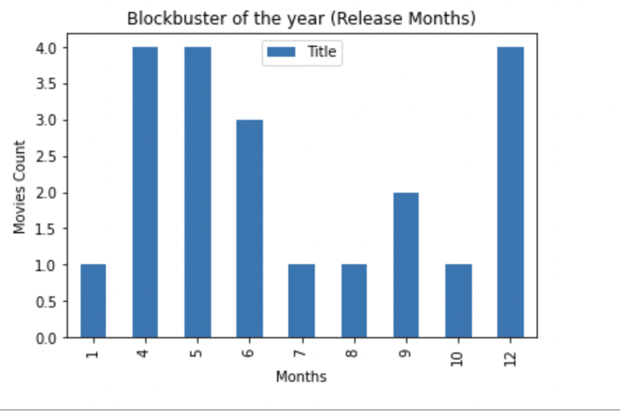
Analyzing release time and profitability here. Looking at graphs we can say that May, December months are best for the release of movies as it has given four biggest blockbusters more than twenty blockbusters and the lowest flops while July and October are not the best time to release movies since they produced high no. of flops and low no. of blockbusters.

Slide 31
Hypothesis test
Do movie genre with higher fan reviews has higher world wide Gross Income?
stats.ttest_ind(prvf_df["Total wgpg"], prvf_df["Total Fan reviews"], equal_var=False)
Ttest_indResult(statistic=2.276770413284427, pvalue=0.03903000759076902)
Our assumption is that high fan reviews per genre is directly proportional to the world wide gross income. In both Total WorldWide Gross Income and Total fan reviews per genre, action movie has the highest values when considering the time period of our analysis. Therefore, we want to confirm (Hypothesis) or negate(Null Hypothesis) that the assumption is verified. from the T_test, the P-Value is 0.039 which below 0.05 which lead us to reject the Null-Hypothesis and confirm the direct proportionality between profit and fan reviews.
even though the hypothesis is verified, the animation genre is the exception. In the Total world wide Gross Income bar chart, Animation was the genre with the second best total gross Income. its position is different when considering the fan reviews. In fact animation is at the fourth position after comedy and Drama which were rispectively at the third and fourth position in terms of total worldwide gross income

Slide 32
Thank You

